Slide 1
Unit 7 Interpret Systems of Equations
Algebra 1

Slide 2
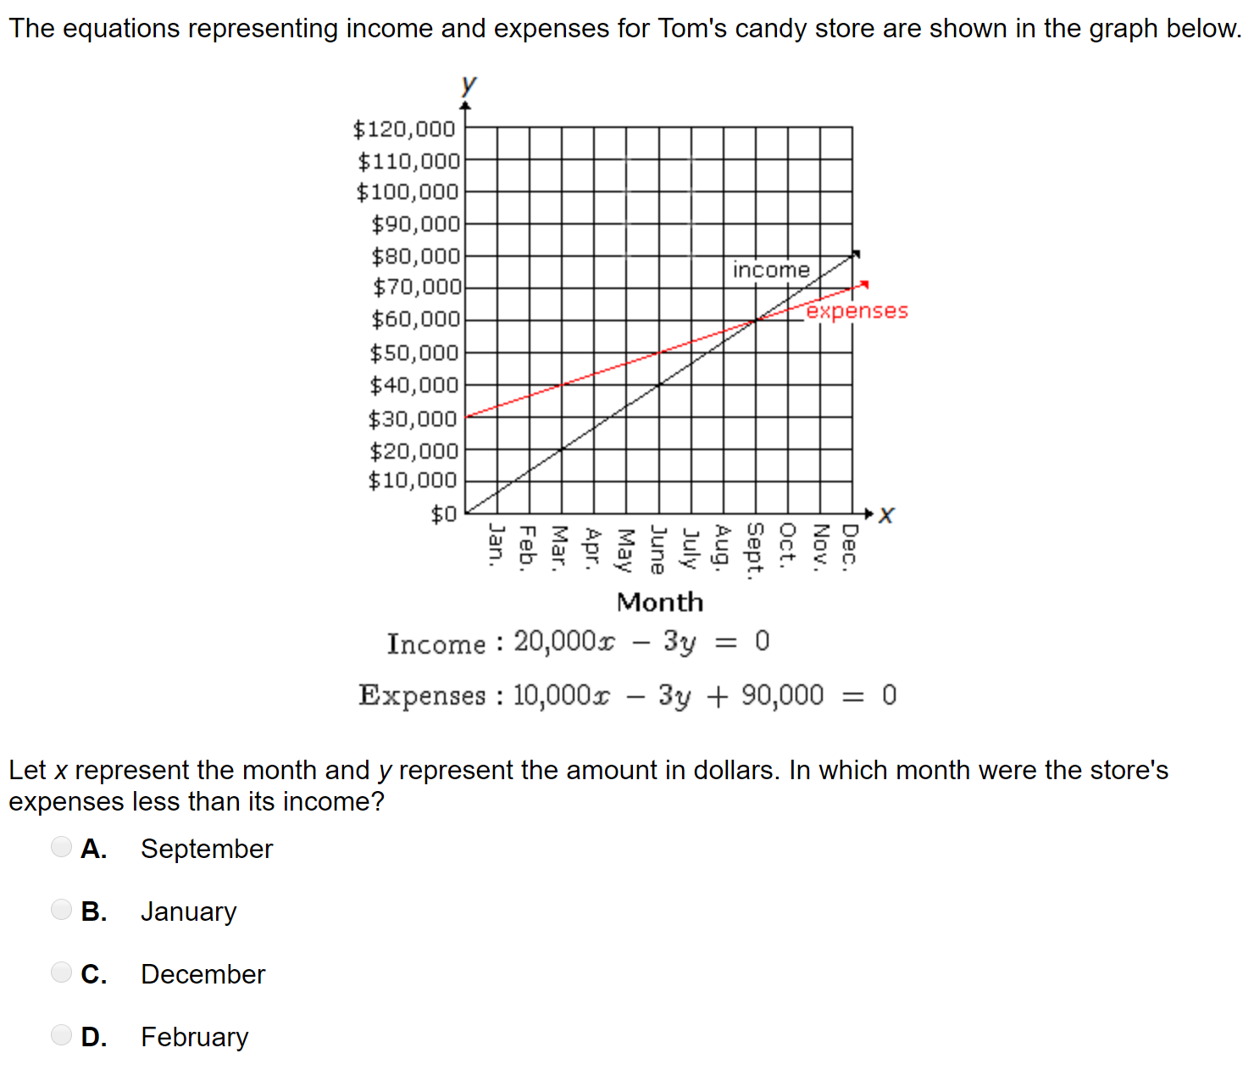

Slide 3
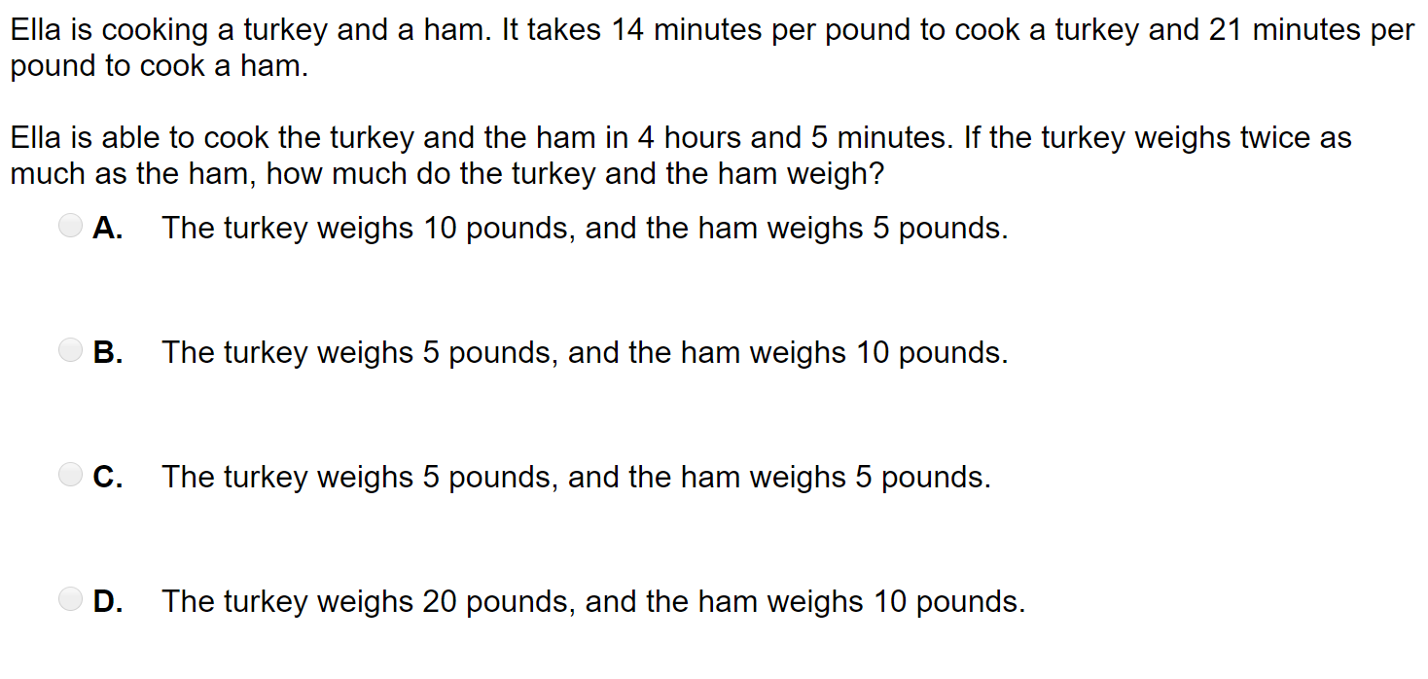

Slide 7
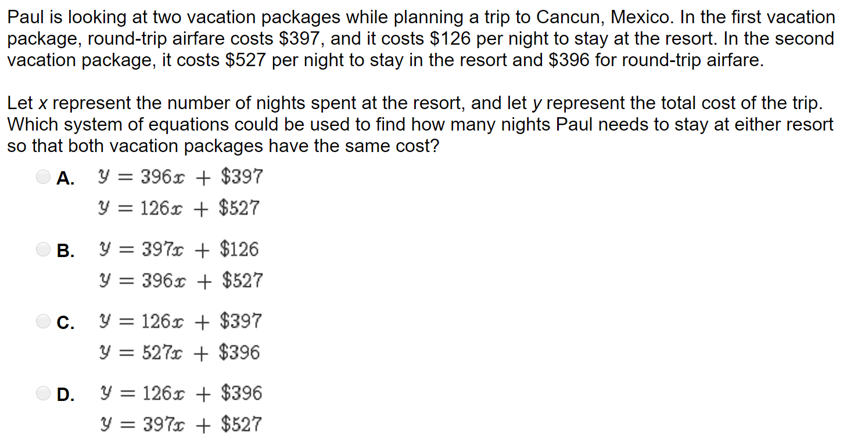

Slide 8
